Slide 1


Slide 2
Database Management System
LAB #03 (ORDER BY, GROUP BY & SUMMARY STATISTICS)

Slide 3
ORDER BY KEYWORD
The ORDER BY keyword is used to sort the result-set in ascending or descending order.
The ORDER BY keyword sorts the records in ascending order by default. To sort the records in descending order, use the DESC keyword.
Syntax is given below:
SELECT column1, column2, ... FROM table_name ORDER BY column1 ASC, column2, DESC;

Slide 4
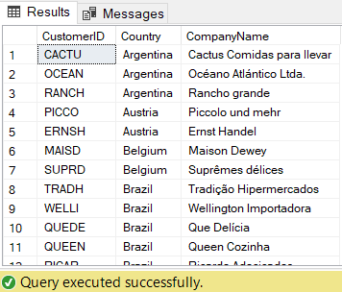
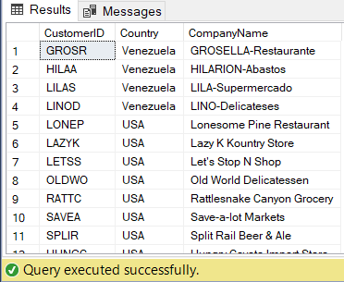
-- ORDER BY ( Desending using DESC)
SELECT CustomerID, Country, CompanyName
FROM Customers
ORDER BY Country DESC;
-- ORDER BY
SELECT CustomerID, Country, CompanyName
FROM Customers
ORDER BY Country;
-- ORDER BY
SELECT CustomerID, Country, CompanyName
FROM Customers
ORDER BY 1 ASC;

Slide 5
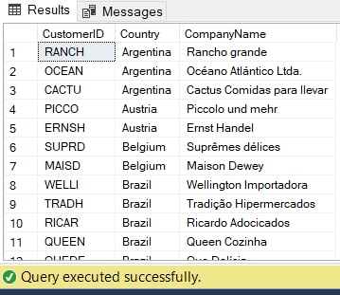
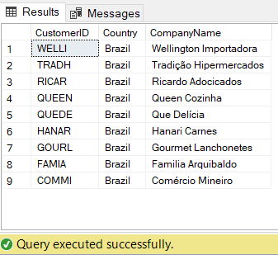
-- companies of Brazil
SELECT CustomerID, Country, CompanyName
FROM Customers
WHERE Country = 'Brazil'
ORDER BY CompanyName DESC;
-- Both Ascending & Desending
SELECT CustomerID, Country, CompanyName
FROM Customers
ORDER BY Country ASC, CompanyName DESC;

Slide 6
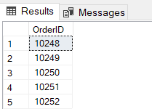
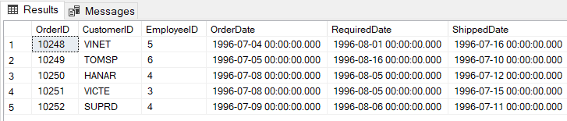
TOP Clause
The SELECT TOP clause is used to specify the number of records to return.
The SELECT TOP clause is useful on large tables with thousands of records. Returning a large number of records can impact on performance.
-- TOP Clause
Select TOP 5 OrderID
FROM Orders;
SELECT TOP 50 PERCENT *
FROM Orders;

Slide 7
MIN() and MAX() Functions
The MIN() function returns the smallest value of the selected column.
SELECT MIN(column_name) FROM table_name WHERE condition;
The MAX() function returns the largest value of the selected column.
SELECT MAX(column_name) FROM table_name WHERE condition;

Slide 8

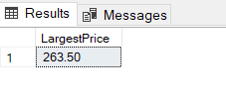
-- MIN() & MAX() Functions
SELECT MIN(UnitPrice) AS SmallestPrice
FROM Products;
SELECT MAX(UnitPrice) AS LargestPrice
FROM Products;

Slide 9
COUNT(), AVG() and SUM() Functions
The COUNT() function returns the number of rows that matches a specified criteria.
The AVG() function returns the average value of a numeric column.
The SUM() function returns the total sum of a numeric column.

Slide 10


COUNT()
AVG()
SELECT AVG(column_name) FROM table_name WHERE condition;
SELECT COUNT(column_name) FROM table_name WHERE condition;
-- COUNT() Function
SELECT COUNT(ProductID) AS prod_count
FROM Products;
-- AVG() Function
SELECT AVG(UnitPrice) AS AverageofUnitPrice
FROM Products;

Slide 11

SUM()
SELECT SUM(column_name) FROM table_name WHERE condition;
-- SUM() Function
SELECT SUM(Quantity) AS SumofQuantity
FROM [Order Details];

Slide 12
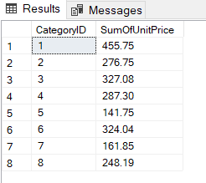
GROUP BY
The SQL GROUP BY statement is used along with the SQL aggregate functions to provide means of grouping the result dataset by certain database table column(s).
-- GROUP BY
SELECT CategoryID, SUM (UnitPrice)AS SumOfUnitPrice
FROM Products
GROUP BY CategoryID;

Slide 13
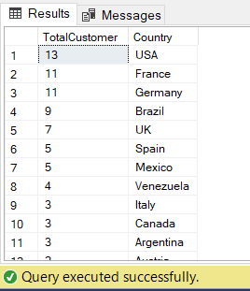
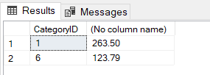
-- GROUP/ORDER BY
SELECT COUNT(CustomerID) AS TotalCustomer, Country
FROM Customers
GROUP BY Country
ORDER BY COUNT(CustomerID) DESC;
-- GROUP BY, HAVING & MAX()
SELECT CategoryID, MAX (UnitPrice)
FROM Products
GROUP BY CategoryID
HAVING MAX (UnitPrice)>90;
-- GROUP/ORDER BY
SELECT COUNT(CustomerID) AS TotalCustomer, Country
FROM Customers
GROUP BY Country → (Mandatory)
ORDER BY COUNT(CustomerID) DESC;

Slide 14
SUMMARY:
Comparison Operators (AND, OR, NOT, BETWEEN)
LIST OPERATOR (IN , NOT IN)
NULL CLAUSE (IS NULL, IS NOT NULL)
SQL Wildcard ( _, %, [], [^])
Ordering (ORDERBY, ASC, DESC)
Limiting (TOP)
Functions (MIN(), MAX(), COUNT(), AVG(), SUM())
Grouping (GROUP BY)
Containing (HAVING)

